Slide 1


Employee Attrition Prediction(using SparkML)
Guided BY- Project By–
Dr. SHANTANU PATHAK Aparna jore(229313)
Prajakta WADJE(229332)

Slide 2
Problem Statement
To develop an accurate machine learning model that can predict employee attrition based on different features and use this model to identify the factors that contribute to employee attrition.

Slide 3
Technologies Used in Project
Databricks Community Edition
Spark SQL, Spark ML
AWS S3(Simple Storage Service)
AWS Lambda
AWS Glue
AWS CloudWatch
AWS IAM(Identity and Access Management)
AWS Athena

Slide 4
About Dataset
Employee Attrition dataset of IBM from Kaggle
Contains information about the employees of a company
Consists of 1,470 rows and 35 columns, including features such as age, gender, education level, job role, salary, work environment satisfaction, performance rating and the reason for an employee's departure.

Slide 5
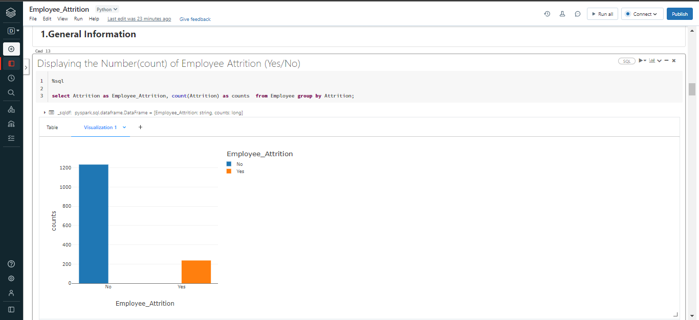
Exploratory Data Analysis using SparkSQL

Slide 6
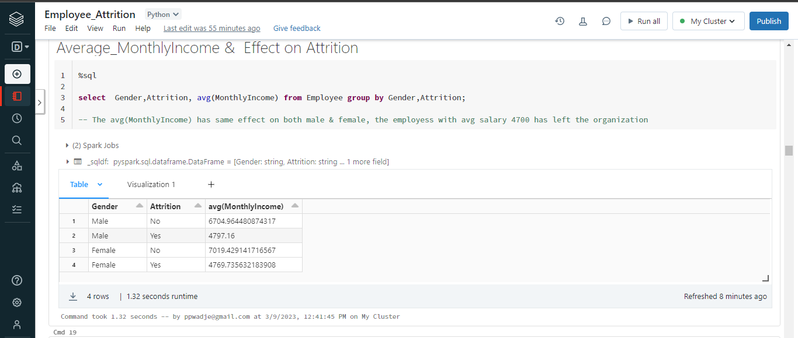

Slide 7
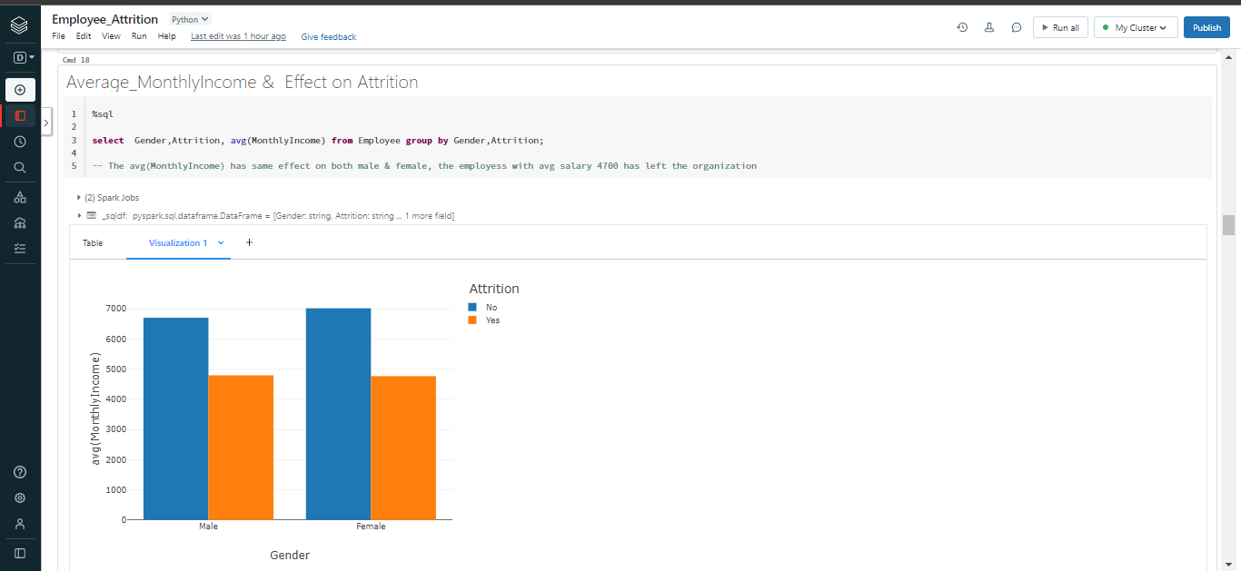

Slide 8
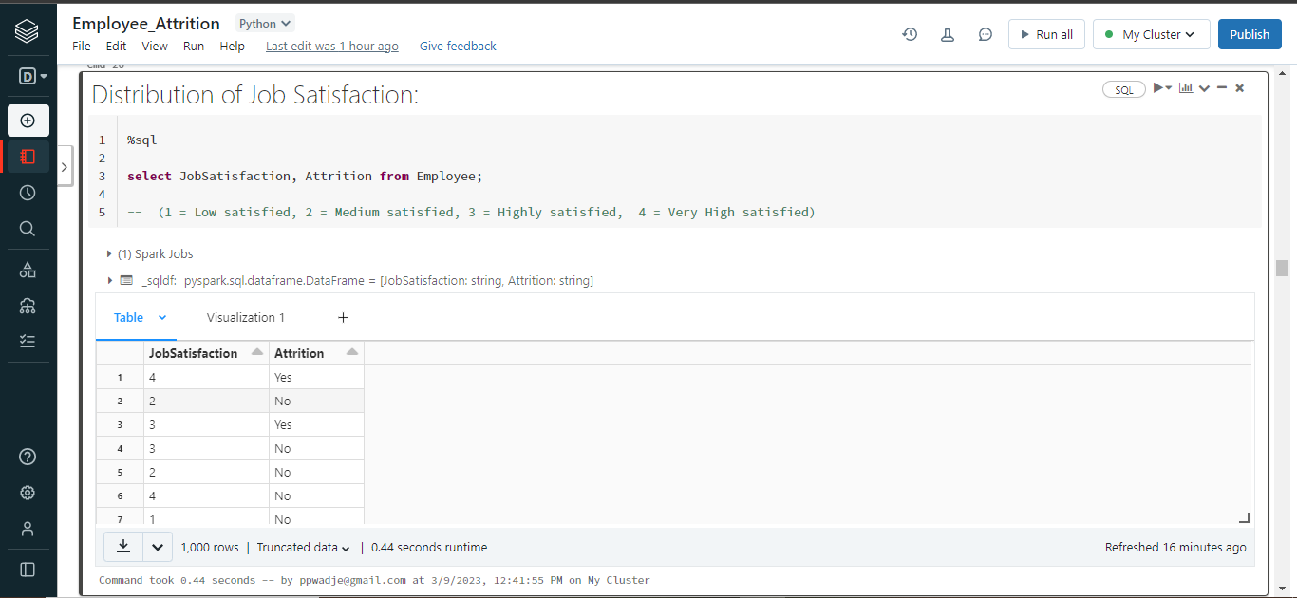

Slide 9
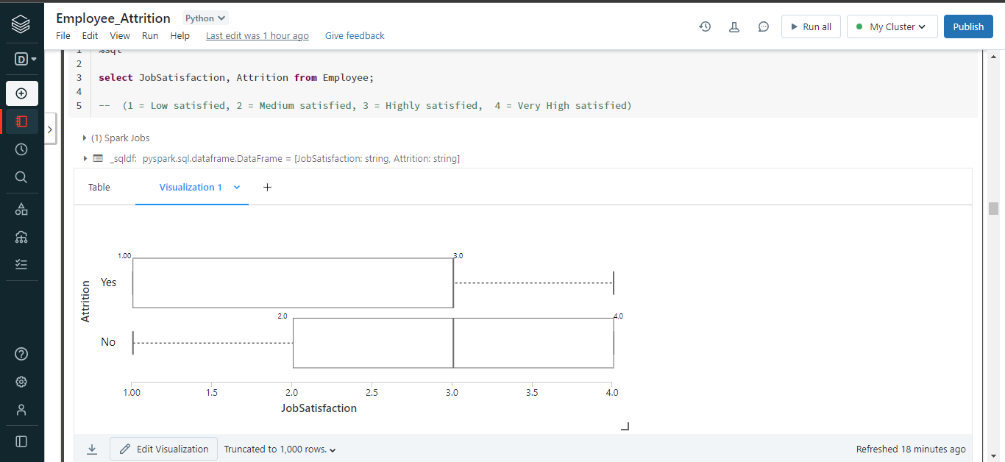

Slide 10
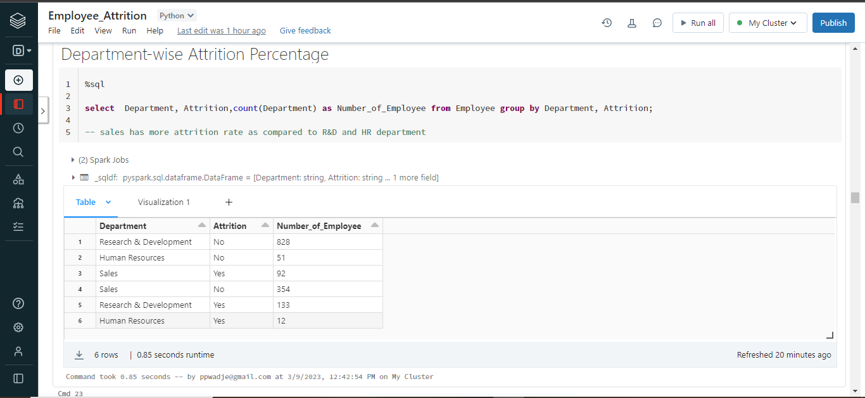

Slide 11
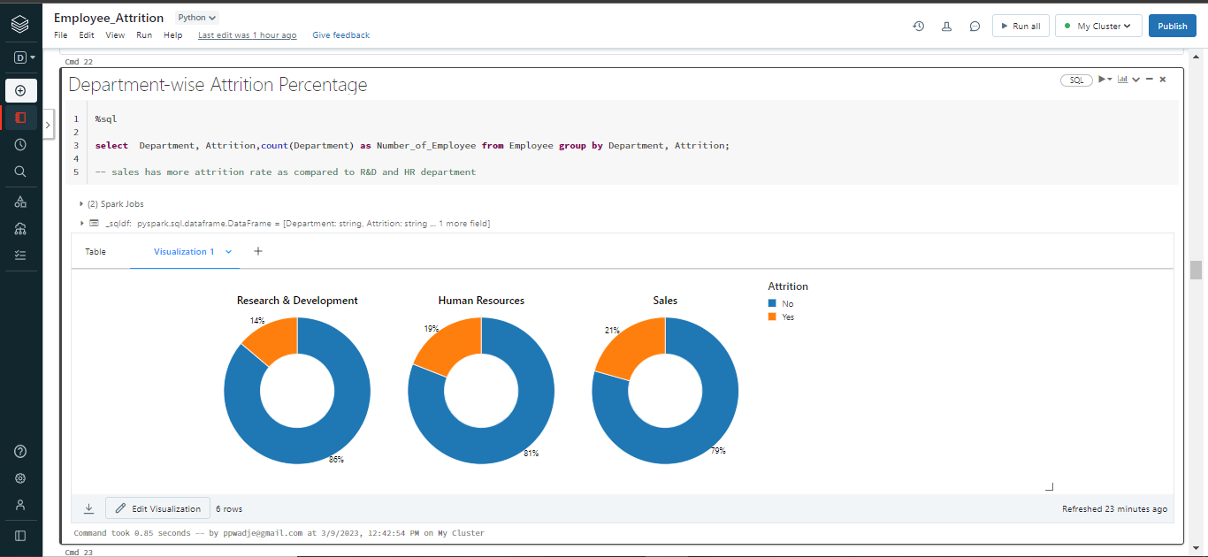

Slide 12
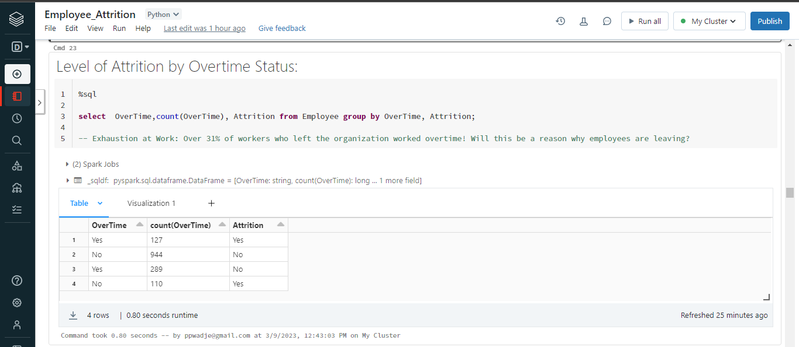

Slide 13
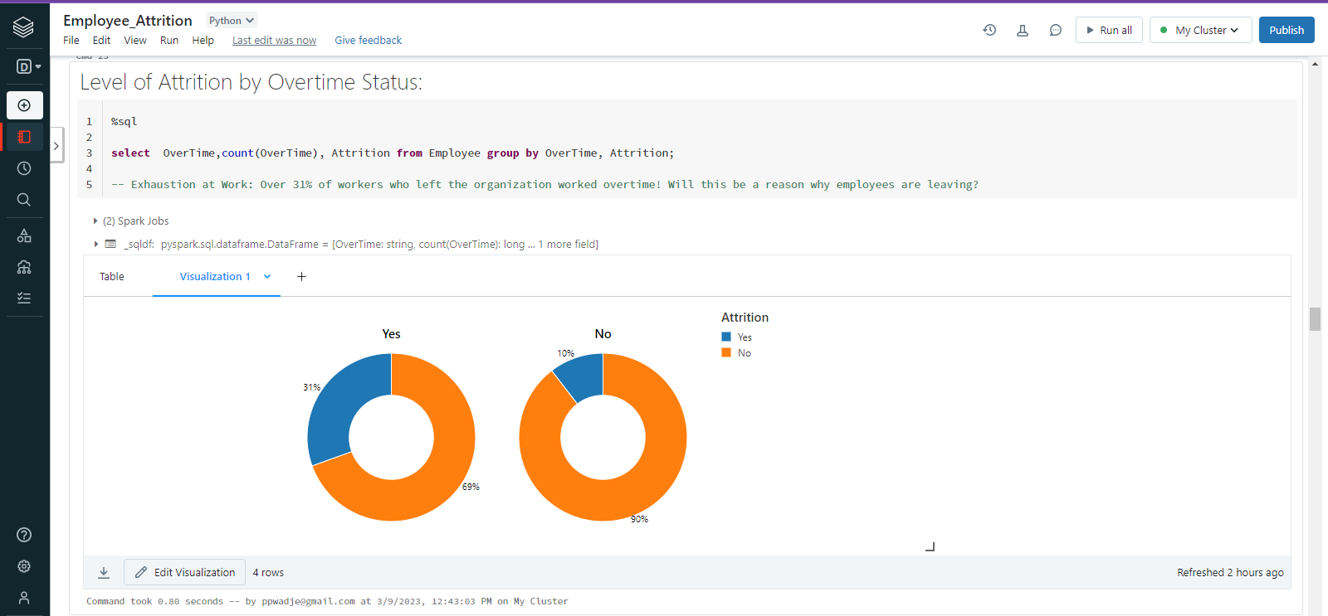

Slide 14
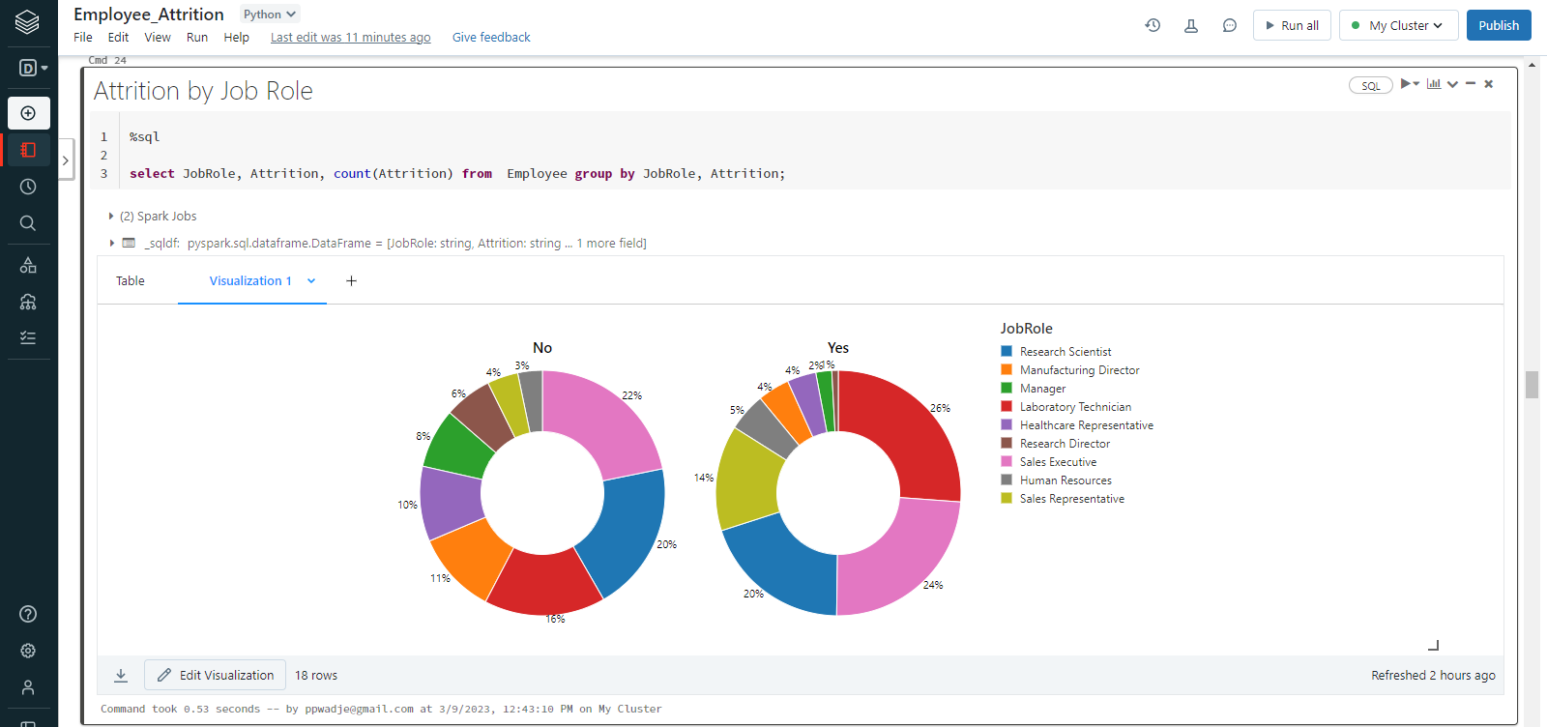

Slide 15
About Data Pre-processing
Checking NA values and handling them using Imputer
Conversion of categorical columns to numerical format using StringIndexer
Forming a feature vector by combining converted categorical columns with numerical columns by using a VectorAssembler

Slide 16
Preparing a Model
Handling the imbalanced label data using Stratified Sampling
Splitting the data into train and test
Using Decision Tree Classifier and Linear SVM
for prediction

Slide 17
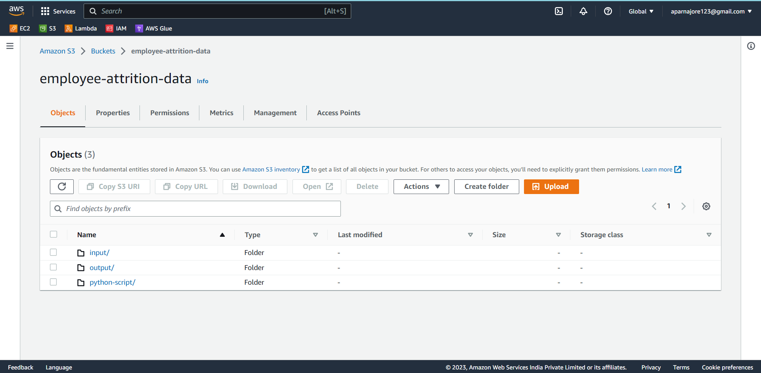
Automation using AWS services
Step 1: Data Ingestion into an S3 Bucket

Slide 18
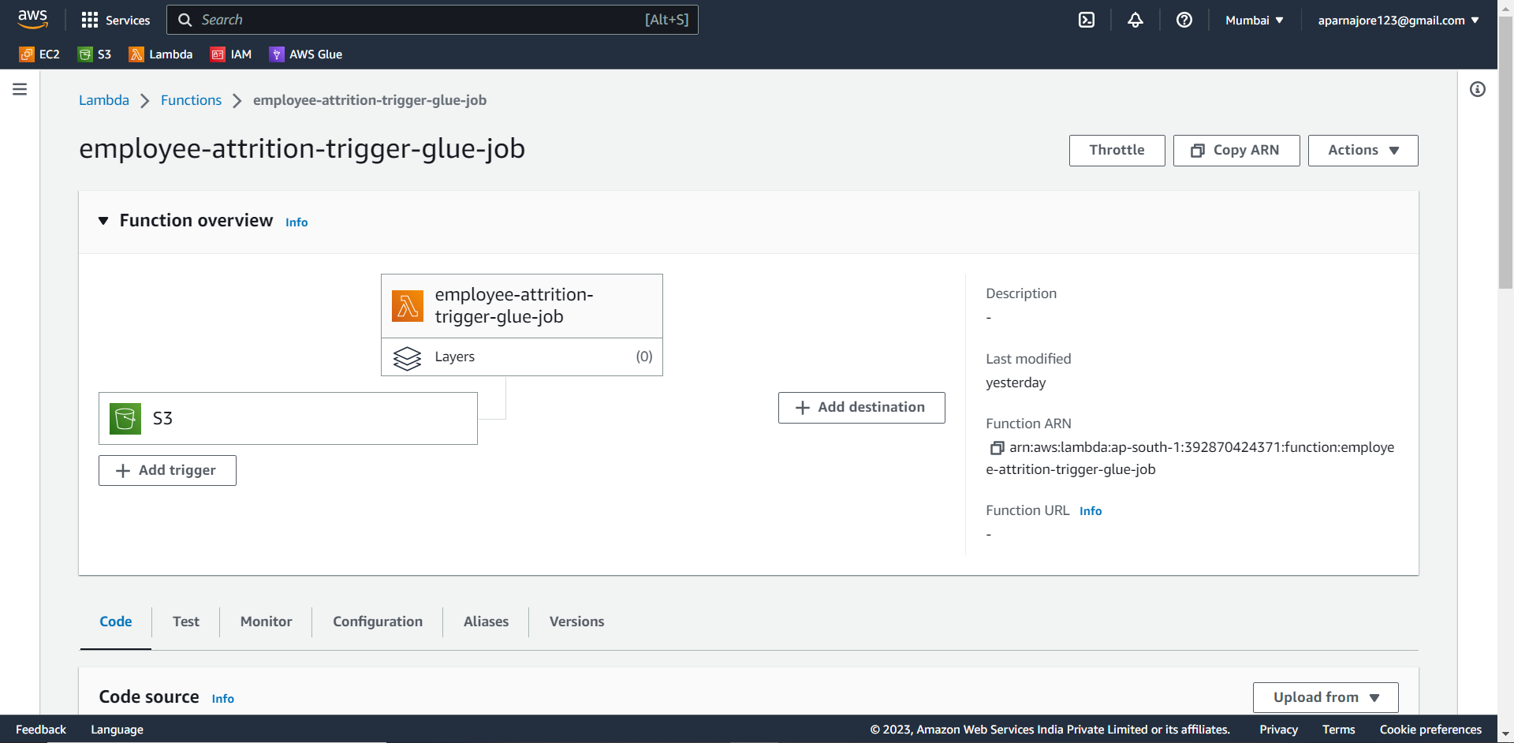
Step 2: Creation of a Lambda Function

Slide 19
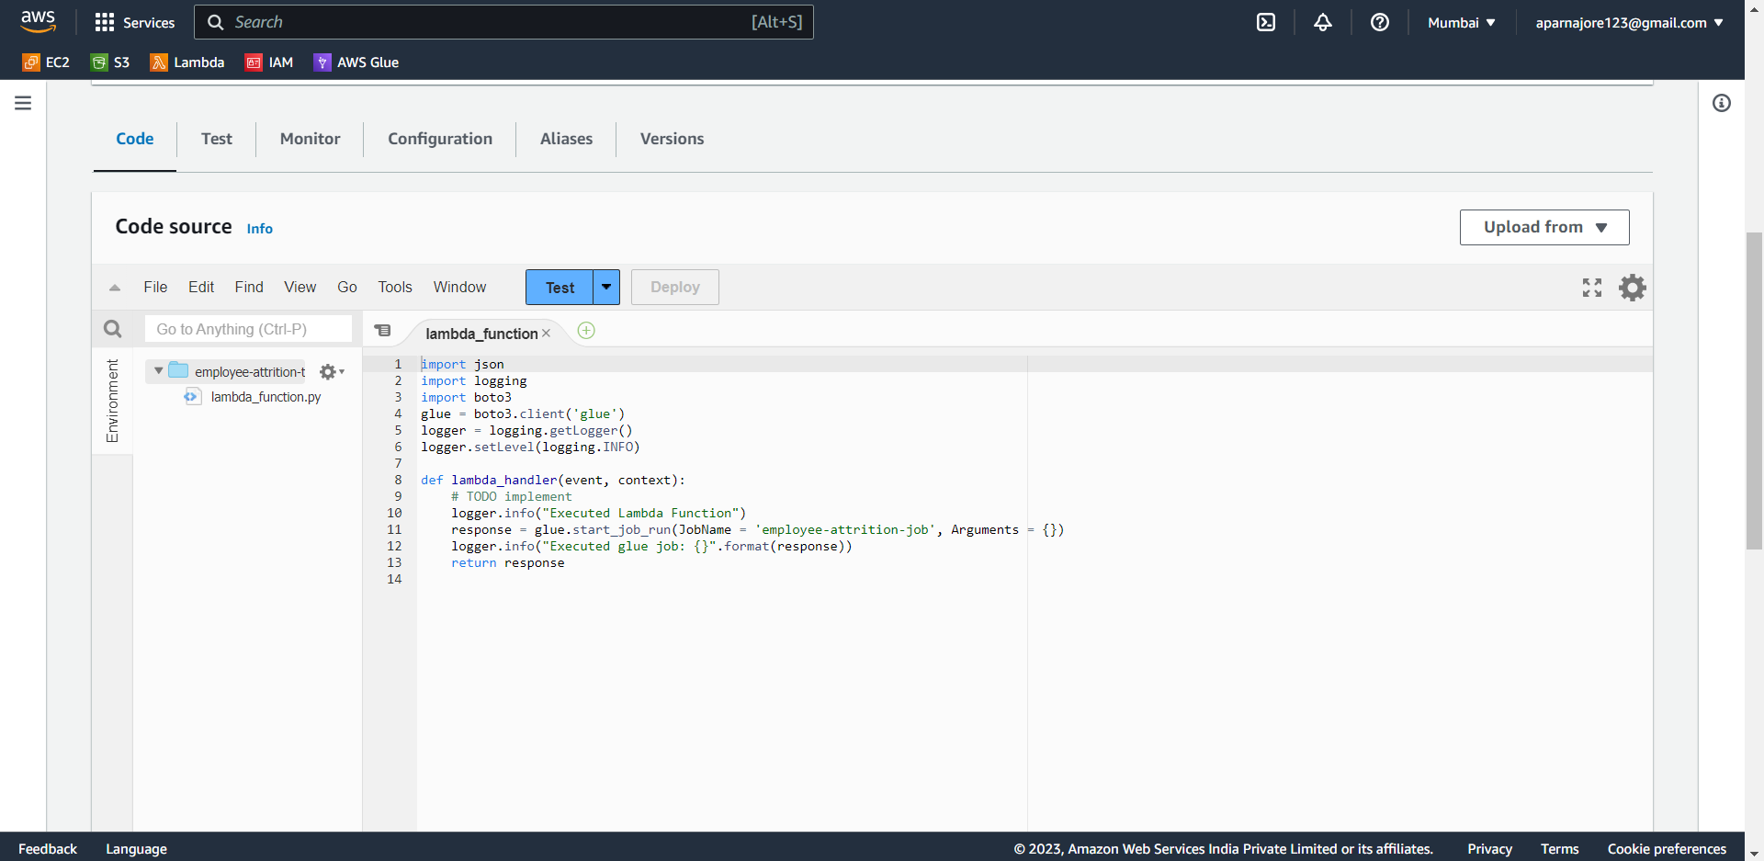

Slide 20
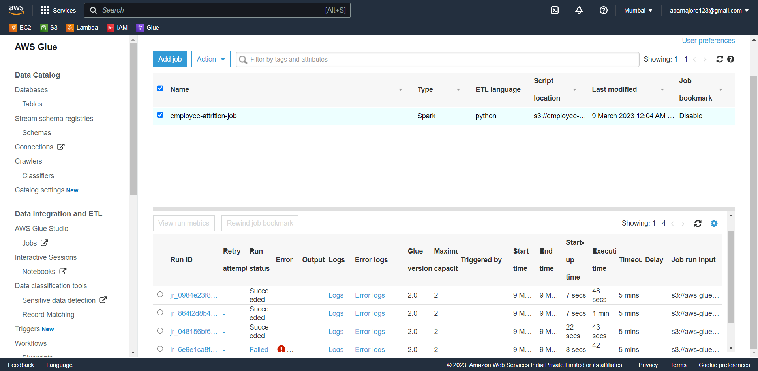
Step 3: Defining a Glue Job

Slide 21
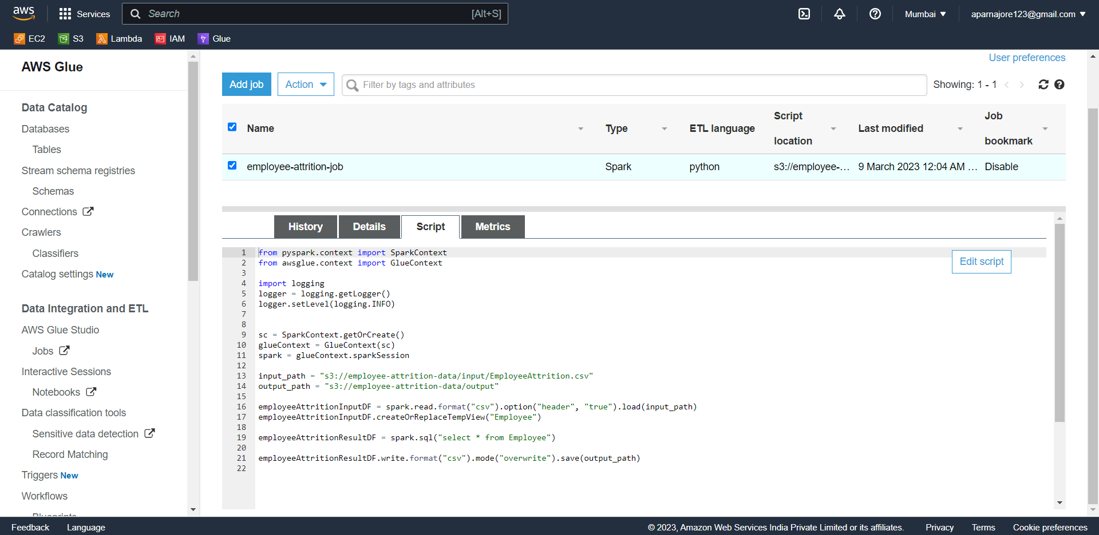

Slide 22
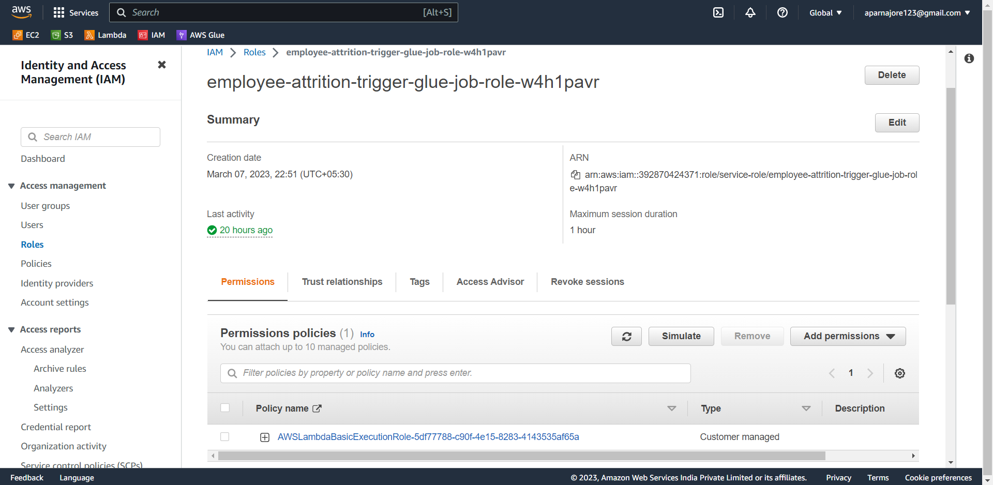
Step 4: Defining IAM(Identity and Access Management) Roles

Slide 23
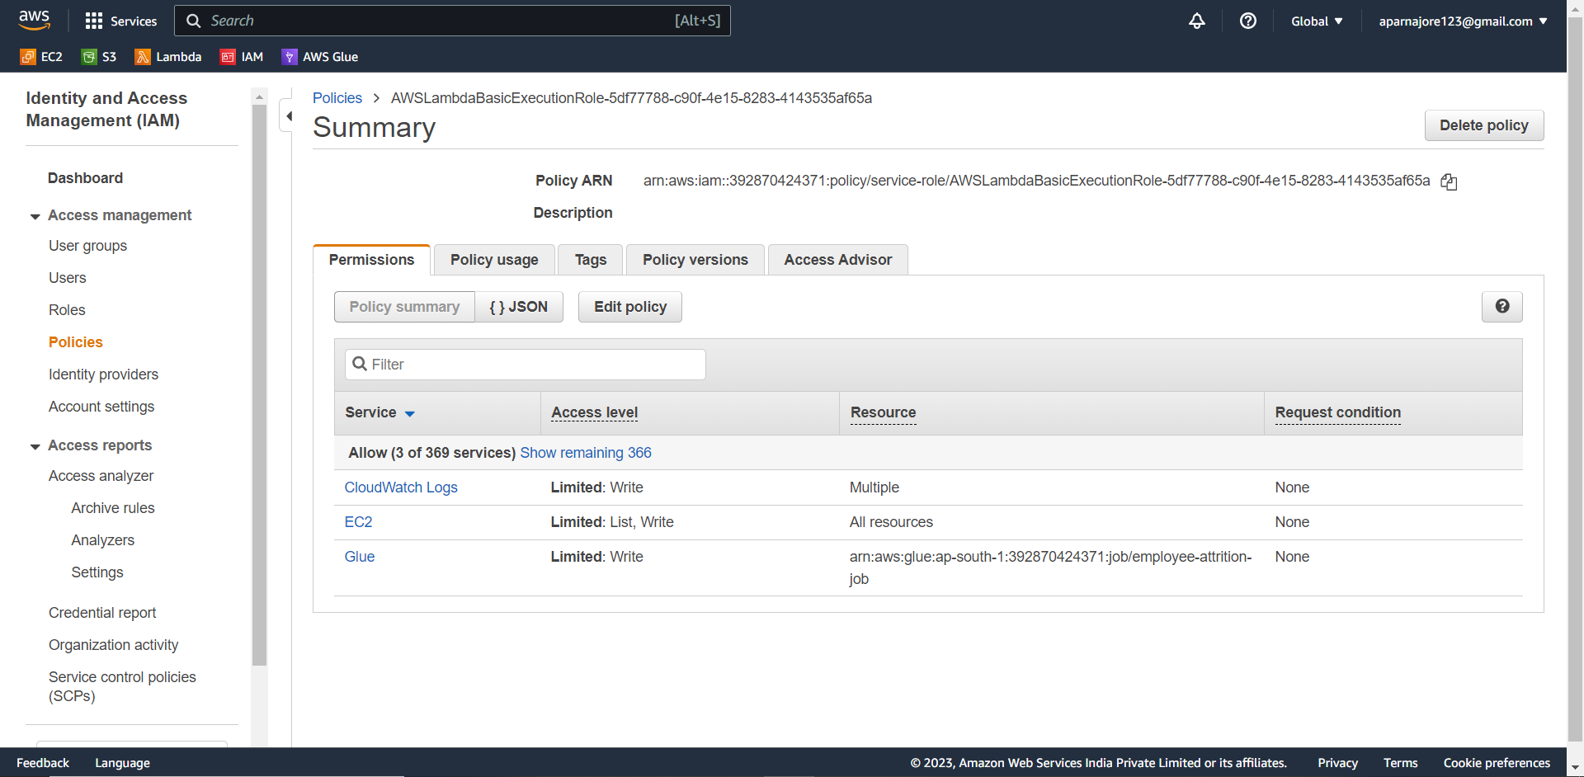

Slide 24
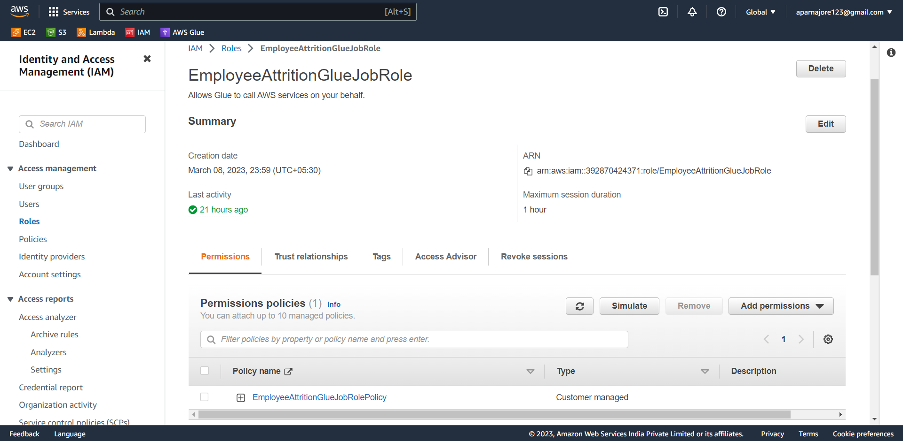

Slide 25
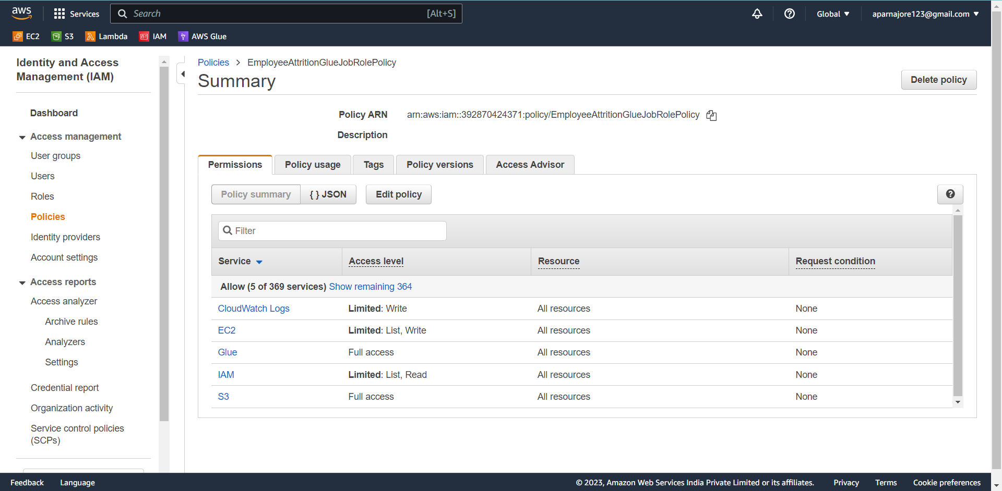

Slide 26
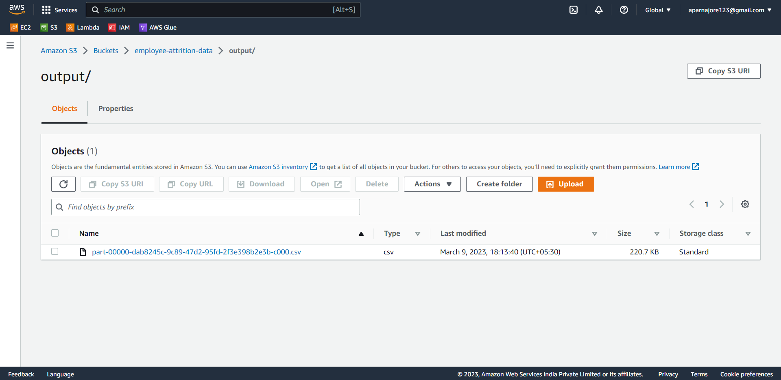
Results:

Slide 27
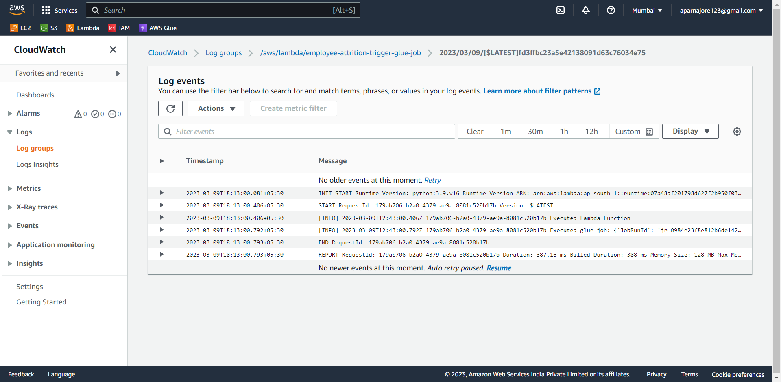
AWS CloudWatch Logs

Slide 28
Thank You

